Slide 1
Patent Equity
MIT Collaboration Data Analysis
Sponsor: Prof Jordi Goodman
Data Collection: Yuxin Liang, Zihua Xin, Wanyi Chen
Data Analysis: Weirun Huang, Jiarui Fu

Slide 2
Project Goal
To investigate gender disparity in patents, articles and conference proceedings and how the disparity has changed over time
To determine if newer professors are experiencing the same disparity
Three teammates working on data collection and two teammates working on data analysis
Notes:
Whether gender disparity exists in patents, articles and conference proceedings and how the disparity has changed over time

Slide 3
Data Collection
Scraped information for 1401 professors from the MIT collaboration website
Names and departments of the professors
Publishing dates for articles and conference proceedings
USPTO numbers for patents
Filing dates for ~4000 patents from USPTO database
Gender Classification:
Used an online tool, gender-api
Classification based on first names
Notes:
For 6000ish patents with USPTO numbers, we performed a search on USPTO’s database and found the filing dates for 4000 patents.

Slide 4
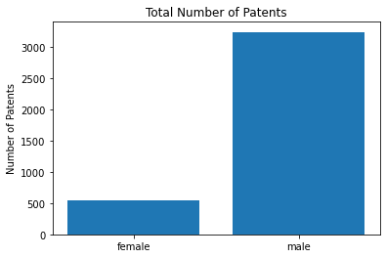
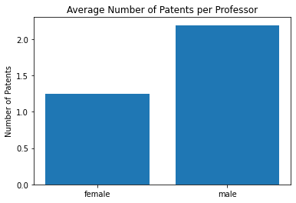
Visualizations
Notes:
For the graph on the left we see large disparity gender

Slide 5
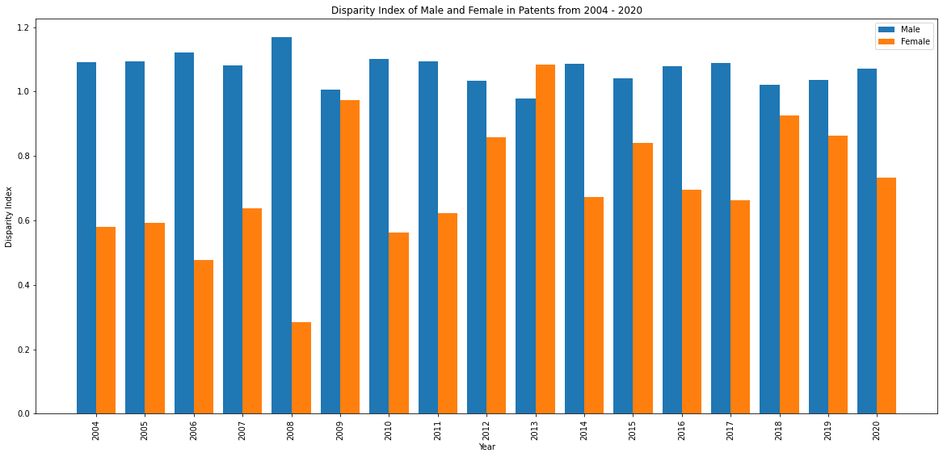
Visualizations
Disparity Index for each of the gender over the year
Notes:
Total number of patents for each gender
Total number of professors for each gender
Disparity Index close to one means the gender is equally represented
High variance in data but overall the trend is improving throughout the time period

Slide 6
Limitations and Expectations
Challenges:
Working with undocumented API
Complex data manipulation in pandas
Limitations
Sacrificing accuracy by using automated process to assign gender
Likely incomplete dataset
Expected next step
Investigate whether newer professors (professors who have been at MIT less than ten years) are experiencing similar disparity to older professors
To complete the project, we will schedule additional meetings with our client and product manager to better assist with the client’s needs
Notes:
Limitations
We had to sacrifice accuracy
Manually searching gender 1400 unrealistic for timeline of our project
Likely incomplete dataset. MIT collaboration website only returns a maximum of 100 professors for each department or center

Slide 7
Thank You

